Slide 1
Azure AD for non-developers
Rory Braybrook
Microsoft Identity Architect
Microsoft MVP
@rbrayb

Slide 2
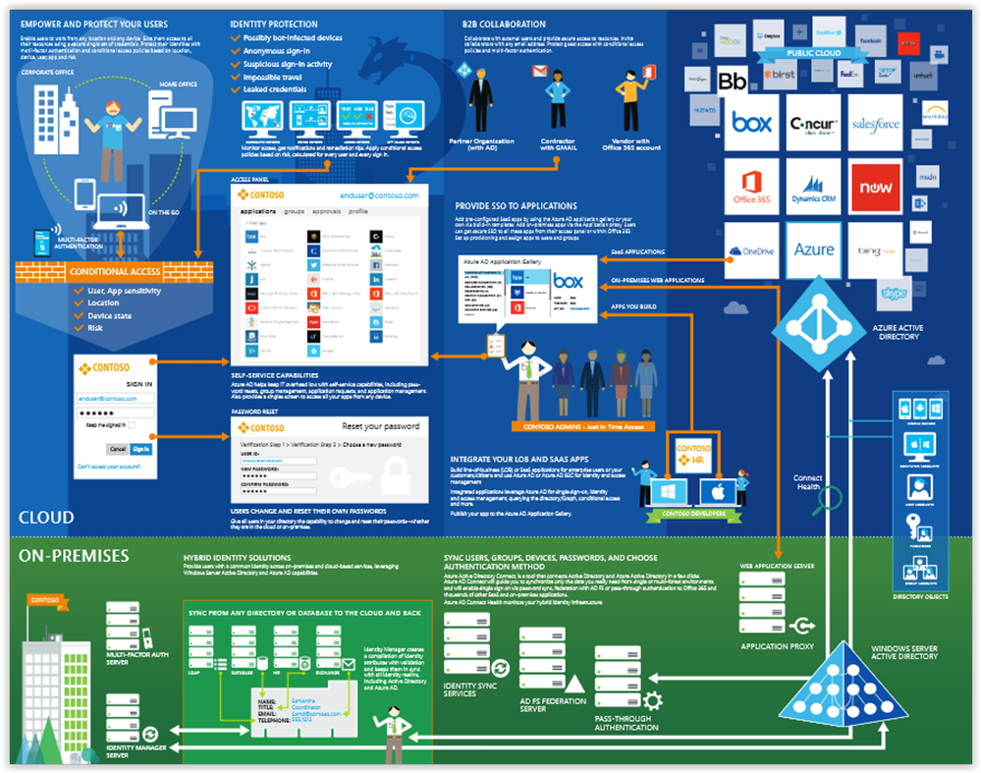

Slide 3
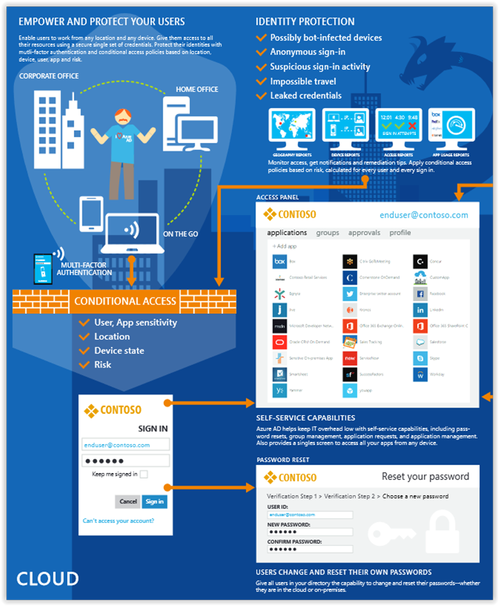

Slide 4
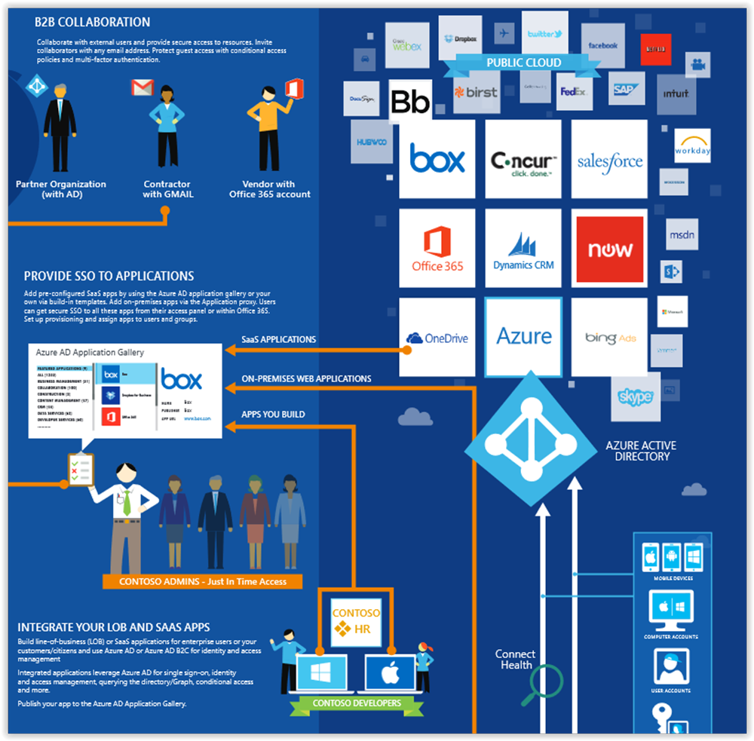

Slide 5
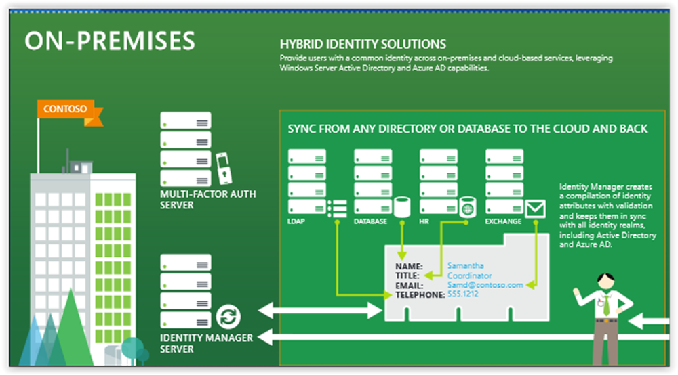

Slide 6
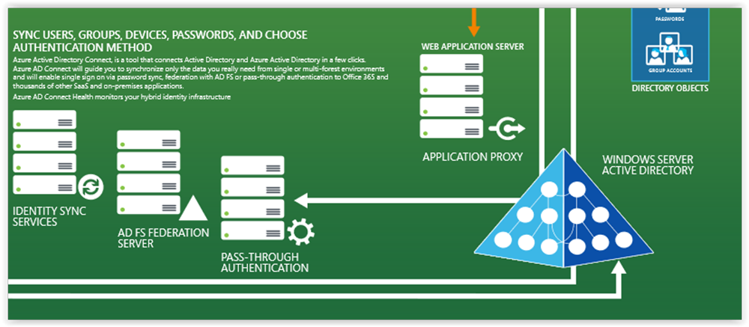

Slide 7
Pricing
Azure Active Directory Free. Provides user and group management, on-premises directory synchronization, basic reports, self-service password change.
Azure Active Directory Premium P1. In addition to the Free features, P1 also lets your hybrid users access both on-premises and cloud resources. It also supports advanced administration, such as dynamic groups, self-service group management, and cloud write-back capabilities, which allow self-service password reset for your on-premises users.
Active Directory Business-to-Customer (B2C).

Slide 8
Pricing
Azure Active Directory Premium P2. In addition to the Free and P1 features, P2 also offers Azure Active Directory Identity Protection to help provide risk-based Conditional Access to your apps and critical company data and Privileged Identity Management to help discover, restrict, and monitor administrators and their access to resources and to provide just-in-time access when needed.
"Pay as you go" feature licenses. You can also get additional feature licenses, such as Azure Active Directory Business-to-Customer (B2C).

Slide 9
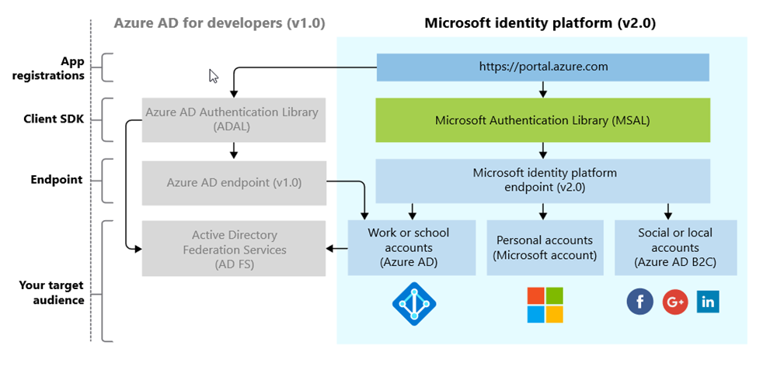
The Platform (not the Product!)

Slide 10
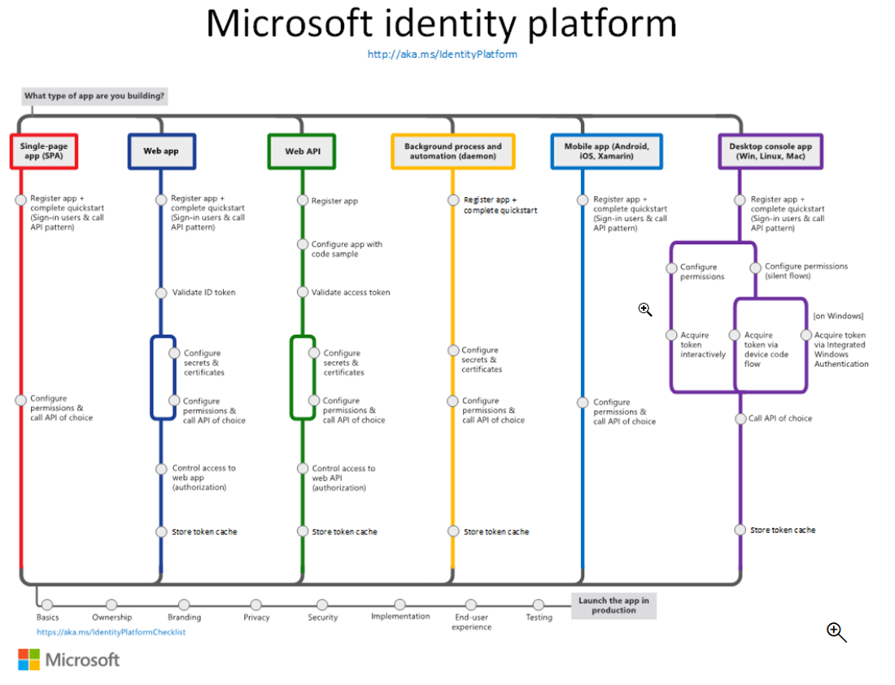

Slide 11
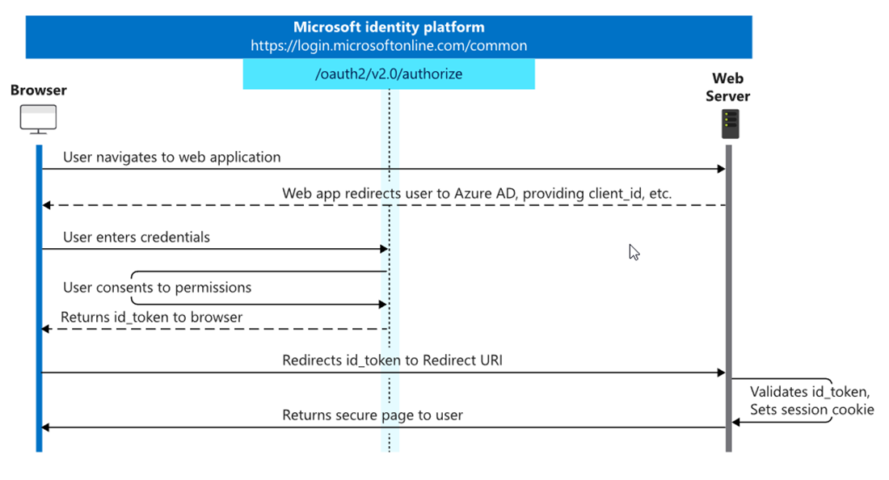
OpenID Connect

Slide 12
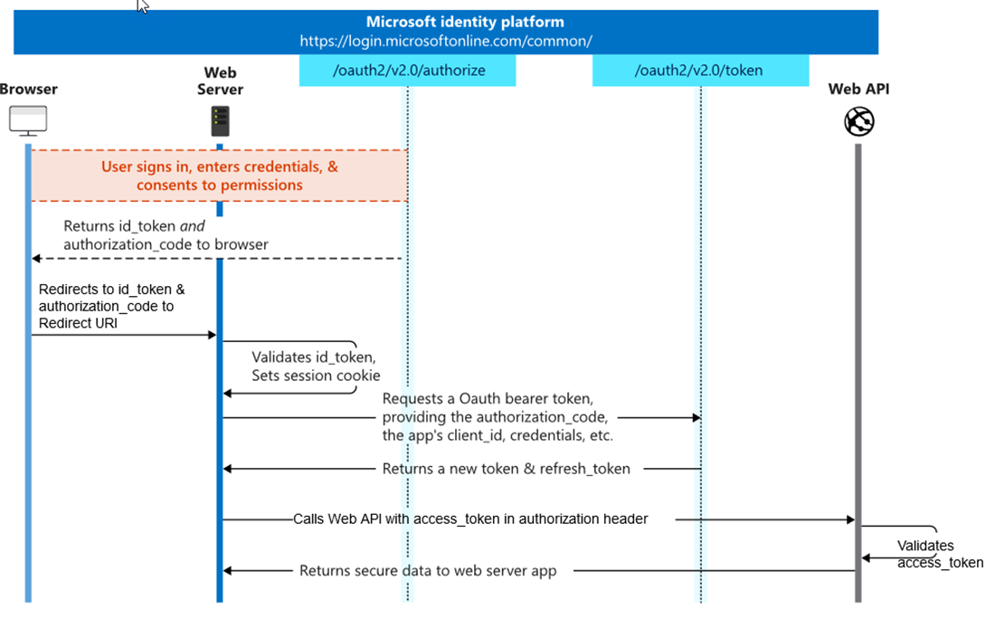
OAuth 2.0

Slide 13
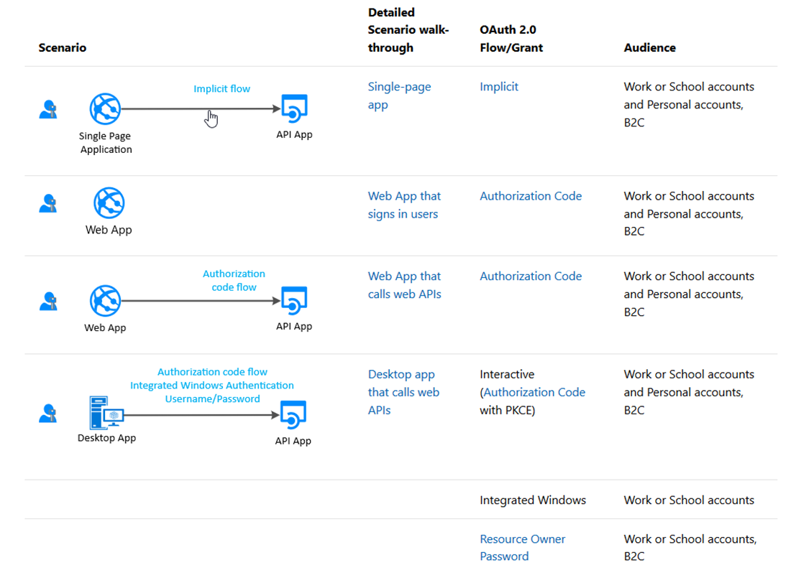
Scenarios

Slide 14
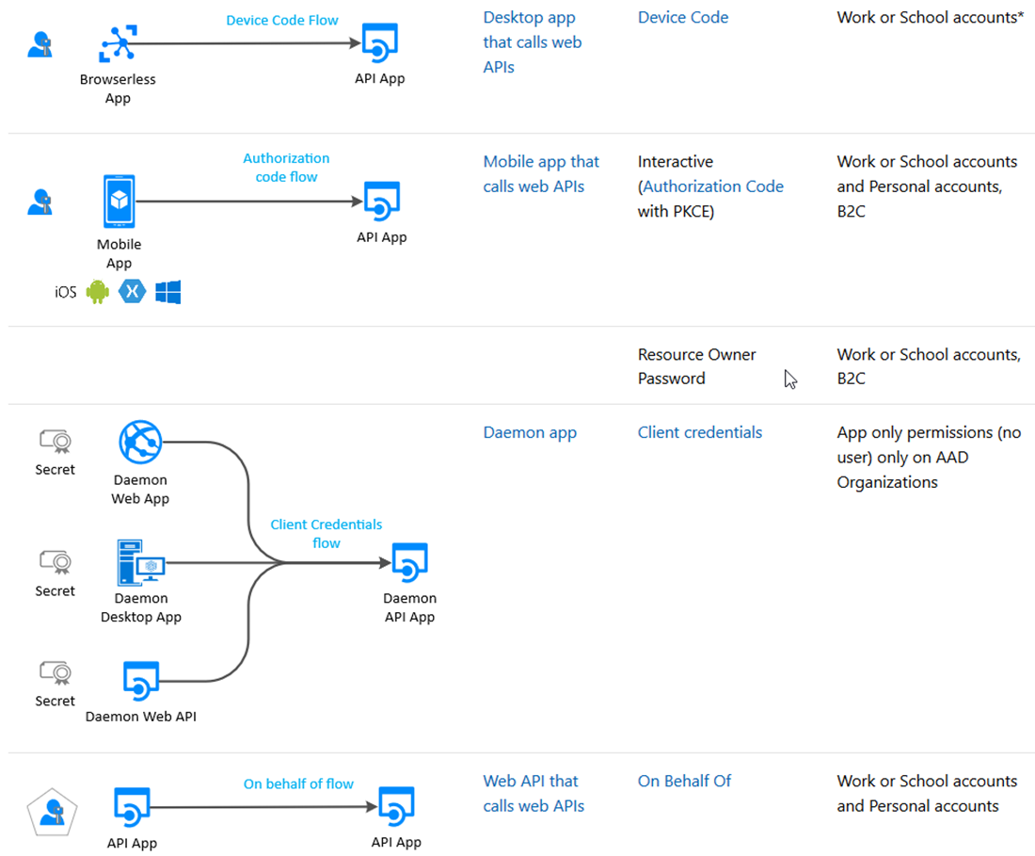
Scenarios

Slide 15
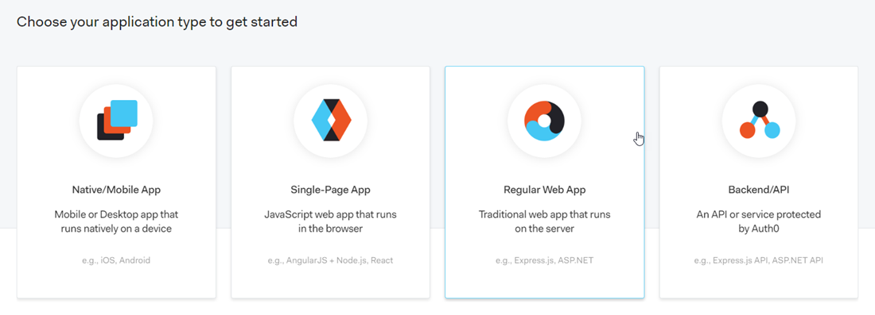
The Format – Auth0

Slide 16
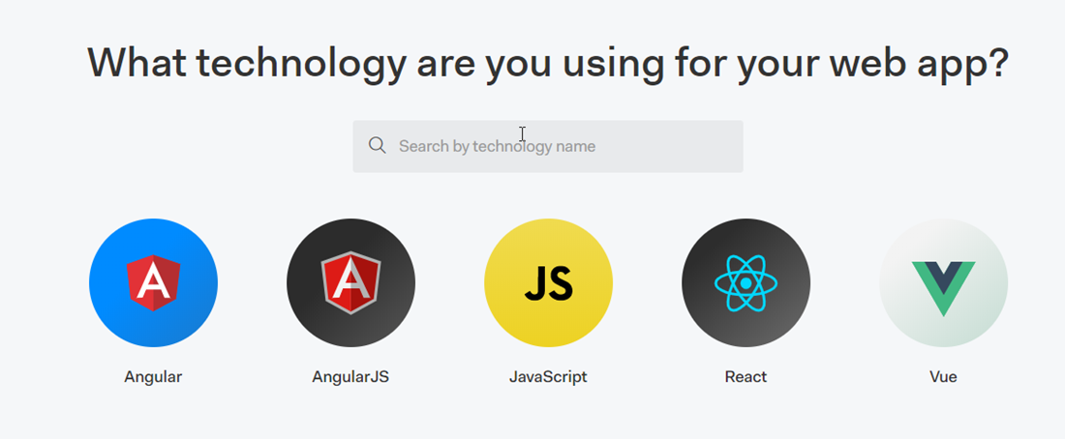
The Format – Auth0

Slide 17
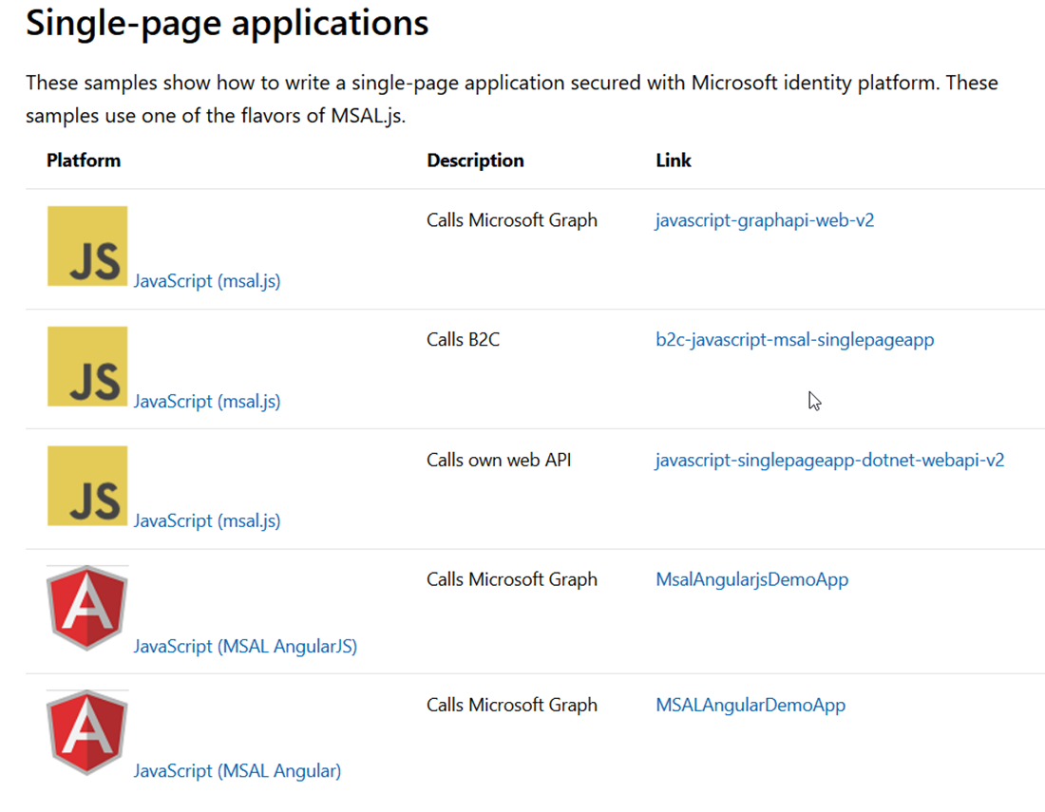
The Format – SPA

Slide 18
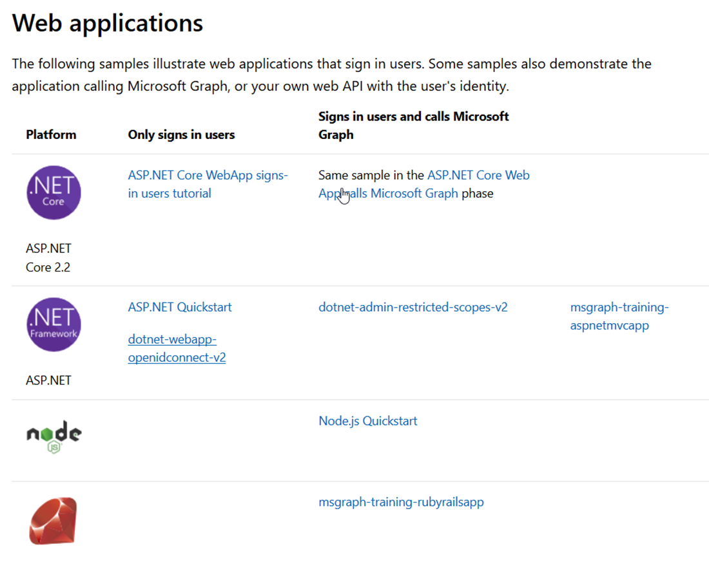
The Format – Web

Slide 19
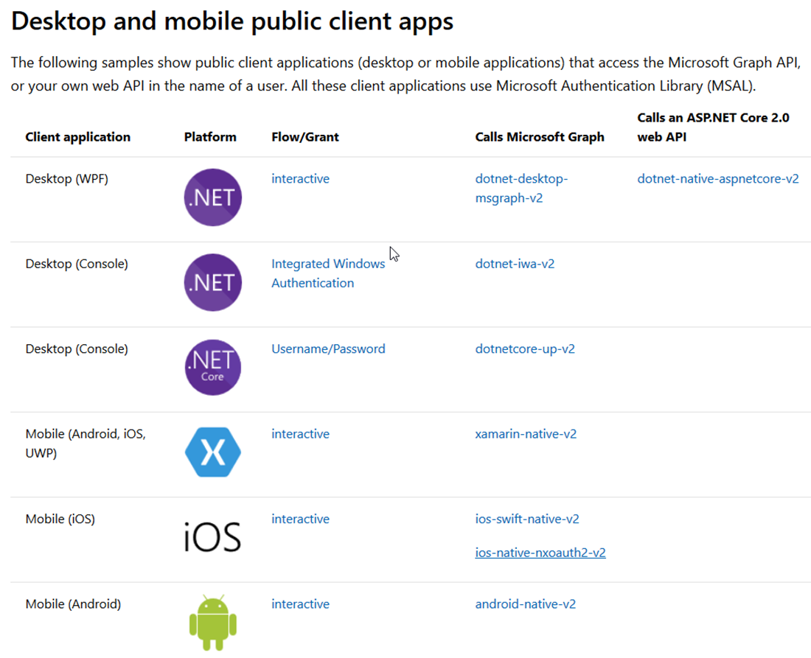
The Format – Native (User)

Slide 20
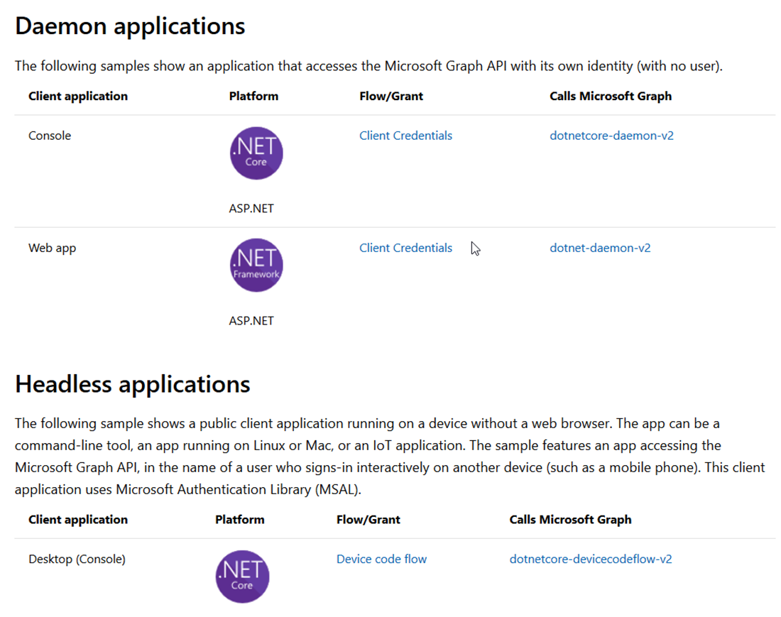
The Format – Native (Application)

Slide 21
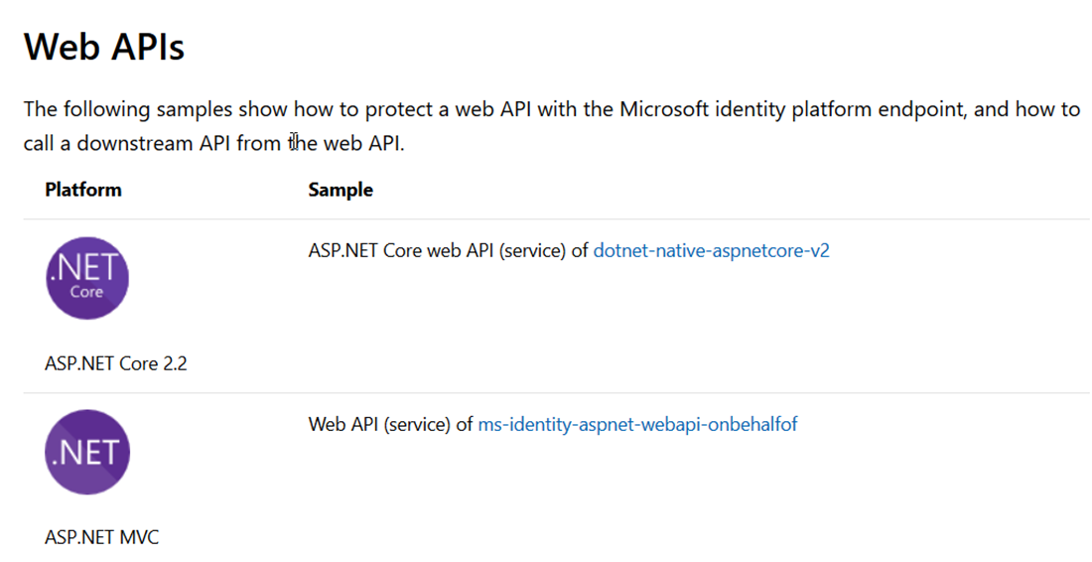
The Format – Web API

Slide 22
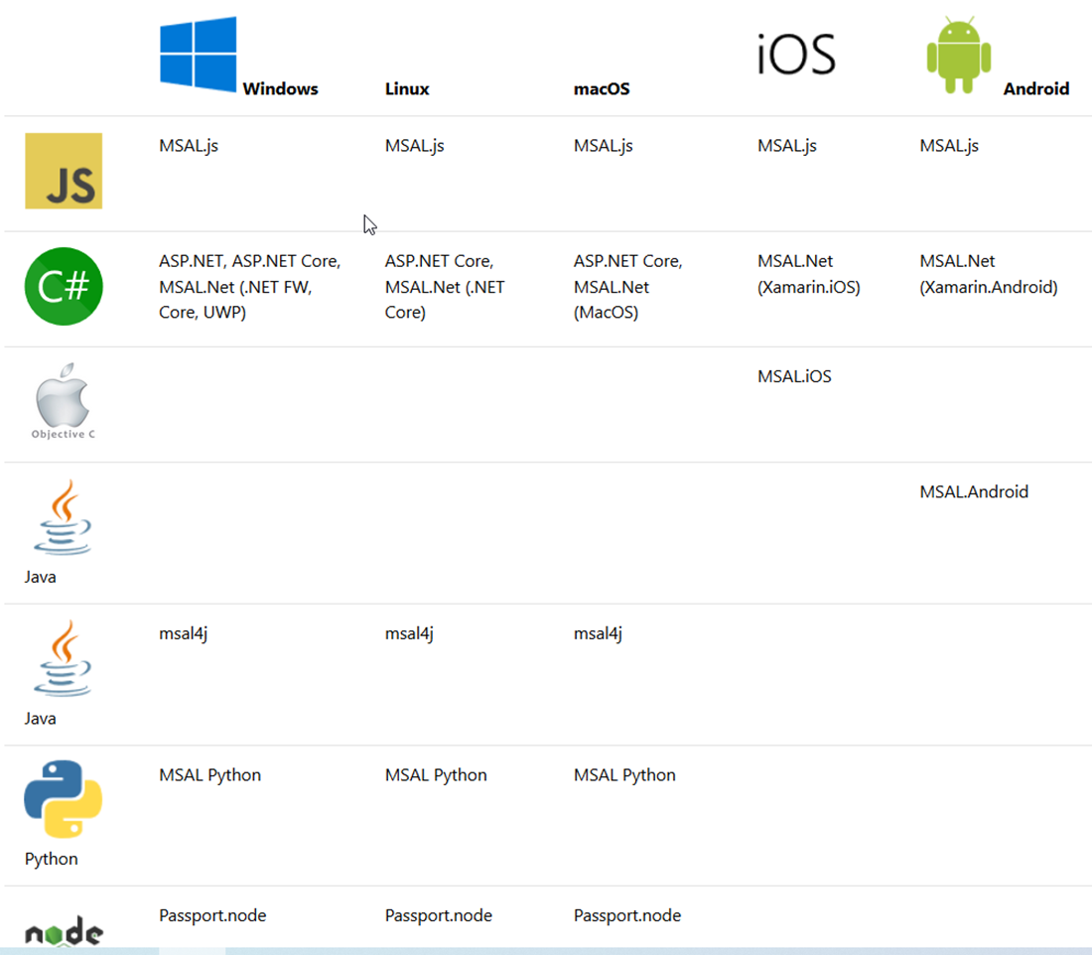
The OS

Slide 23
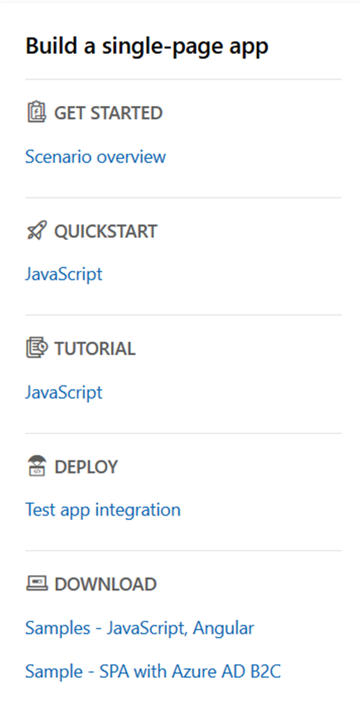
The Menu

Slide 24
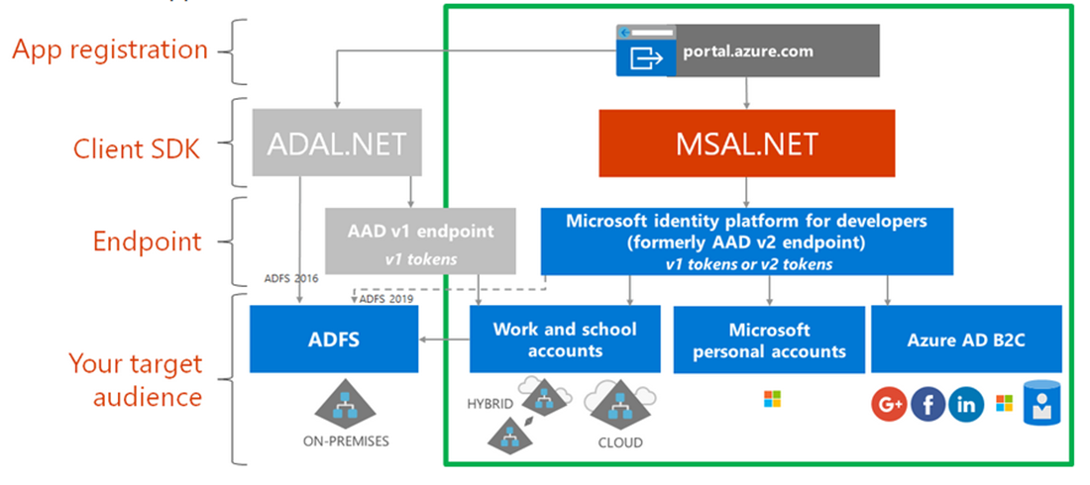
ADAL - MSAL

Slide 25
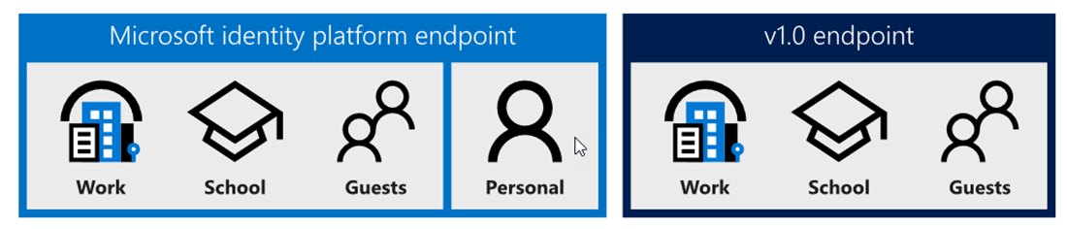
The Endpoints

Slide 26
Types of tenant
You can restrict the types available by modifying the authority URL.
https://login.microsoftonline.com/common/v2.0
The default, allows any account
https://login.microsoftonline.com/organizations/v2.0
Allow only Azure AD/Office 365 accounts
https://login.microsoftonline.com/consumers/v2.0
Allow only personal MS accounts
https://login.microsoftonline.com/{tenant-id}/v2.0
Allow only a specific Azure AD tenant

Slide 27
Resources / scopes
ADAL
Resource URI
https://graph.microsoft.com
MSAL
Scope
https://graph.microsoft.com/Calendars.Read
Scope=Calendars.Read

Slide 28
The rest
MSAL - ADFS
MSAL connects to Azure AD, which is federated with AD FS
MSAL connects directly to AD FS (Server 2019) (Azure Stack)
Can use ADAL (Samples available)
MSAL – Azure AD B2C
JS
.NET
Samples available

Slide 29
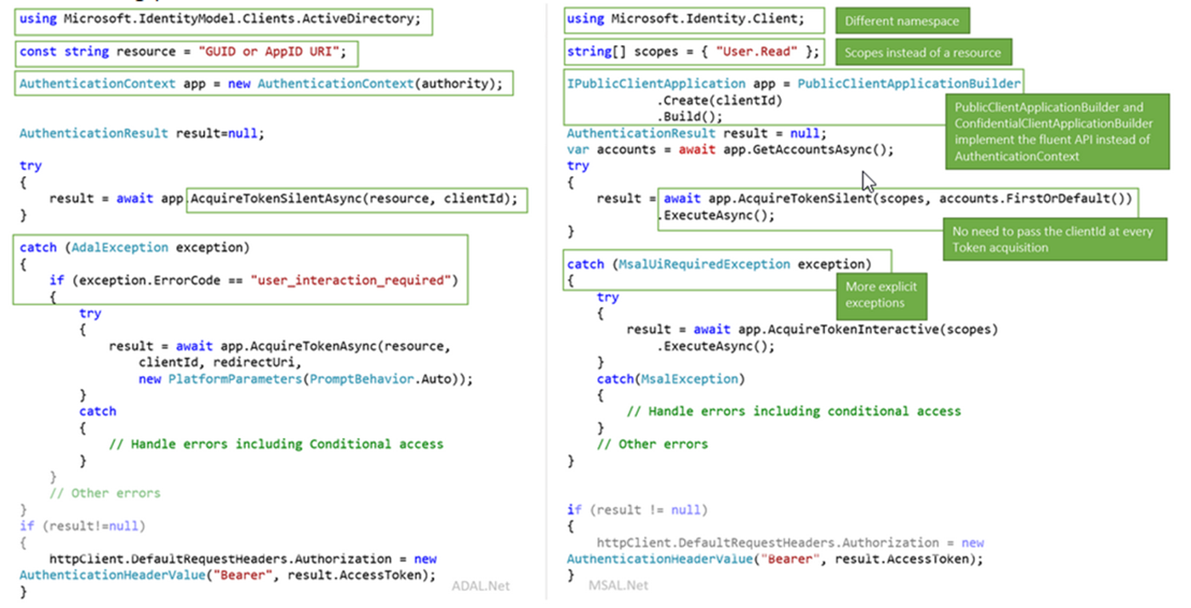
ADAL – MSAL - code

Slide 30
The Demo
The old way
Connected Services
.NET Core B2C
New application registration
Samples

Slide 31
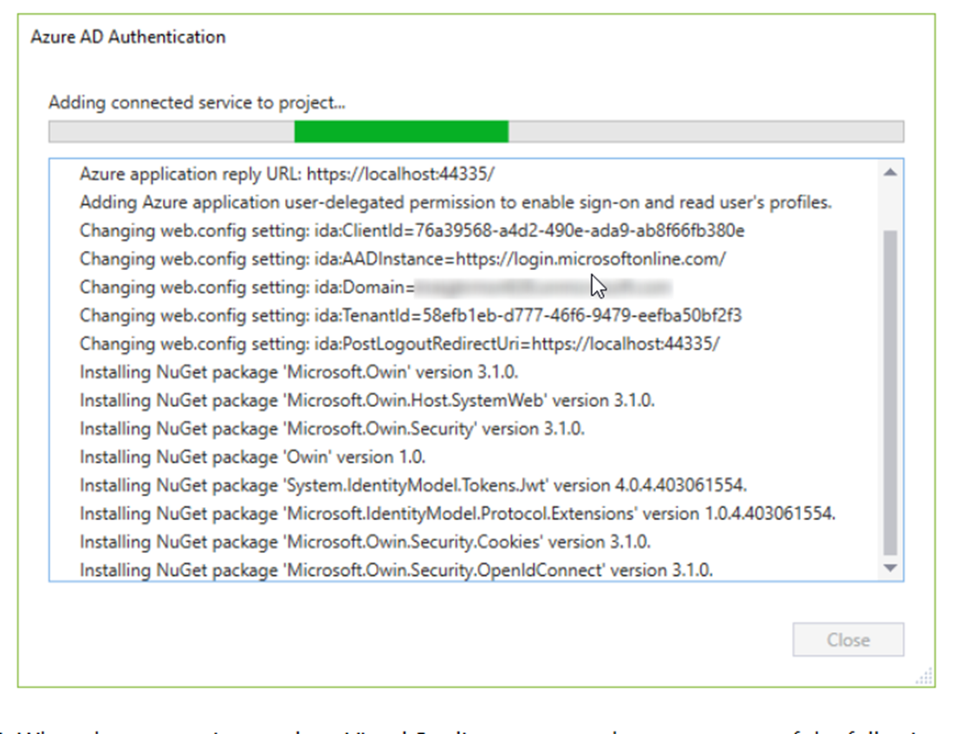
Connected Services

Slide 32
It’s EASY and you get stuff for FREE
It’s easy:
Register your app
Use a quickstart
Request permission to data
The rest comes automatically, with no extra code:
single sign on, token management, passwordless, conditional access

Slide 33
Best practice for single sign on
Always try the silent token acquisition before attempting interactive token acquisition!
This simple pattern enables SSO and handling IT policy.
try
{
result = await app.AcquireTokenSilent(scopes, account).ExecuteAsync();
}
catch(MsalUiRequiredException ex)
{
result = await app.AcquireToken(scopes, account).ExecuteAsync();
}

Slide 34
Best practices for secure authentication
Build your solutions by using libraries (MSAL, .NET middleware)
Clients don’t inspect access tokens (only for intended API)
Don’t store login names and passwords. Use MSAL/B2C
Apps shouldn’t handle raw passwords (avoid ROPC)
Confidential clients (daemon, web services) should use certs
Best practices: aka.ms/msidbestpractice

Slide 35
Best practices for updating to MSAL
Write your new apps using MSAL
Update your ADAL apps to MSAL to get the latest innovation
Guides:
aka.ms/UpdateToMSALjs
aka.ms/UpdateToMSALNet
aka.ms/UpdateToMSALAndroid
aka.ms/UpdateToMSALiOSmacOS

Slide 36

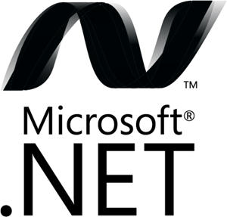




Microsoft Authentication Libraries (MSAL)
Generally Available:
GA
GA
GA
GA
GA
GA
JavaScript
.NET
Android
iOS/macOS
Production Supported Public Preview:
PREVIEW
PREVIEW
Java
Python

Slide 37
Best Practices
Follow the Golden Rules for tokens
Create the best user experience with scopes
Use Roles or Groups
Enable Provisioning
Protect APIs
Protect Services
Protect your apps

Slide 38
Golden Rules for Tokens
Use tokens only for their intended function
ID Tokens identify the user to the application
Access tokens authorize the app for a range of operation for an API
Never mess with someone else’s tokens
Apps do not look at access tokens
APIs never use ID Tokens for authorization
APIs never accept Access Tokens for other APIs
Cache the tokens appropriately
MSAL handles this automatically
Check for error classes instead of search for specific error codes

Slide 39
References
https://azure.microsoft.com/mediahandler/files/resourcefiles/cloud-identity-and-access-management/Cloud_Identity_and_Access_Management_infographic.pdf/
https://docs.microsoft.com/en-us/azure/active-directory/develop/
https://docs.microsoft.com/en-us/azure/active-directory/develop/identity-platform-integration-checklist
https://www.youtube.com/watch?v=y_fgJAatVhk&feature=youtu.be
https://medium.com/the-new-control-plane
https://aka.ms/msidplatform
https://developer.microsoft.com/en-us/identity
https://myignite.techcommunity.microsoft.com/sessions/81635

Slide 40


